Slide 1
December Holiday Celebration Survey
Monday, November 07, 2016

Slide 2
322
Total Responses
Date Created: Monday, October 31, 2016
Complete Responses: 322

Slide 3
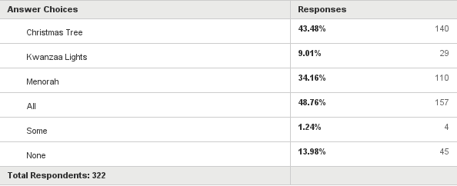
Q1: Which December "holiday" symbol(s) do you think Glen Rock should display in Town?
Answered: 322 Skipped: 0

Slide 4
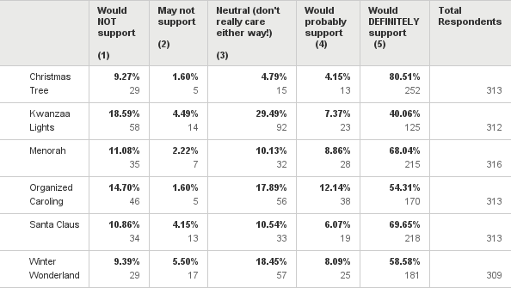
Q2: On a scale of 1 to 5, with 1 being you would NOT support and 5 being you would DEFINITELY support, would you support the following in Glen Rock?
Answered: 319 Skipped: 3

Slide 5
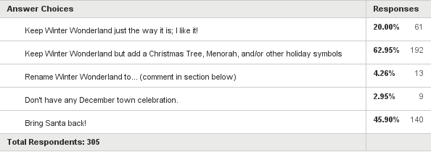
Q3: Do you think Glen Rock should continue with a Winter Wonderland only or incorporate additional symbols?
Answered: 305 Skipped: 17

Slide 6
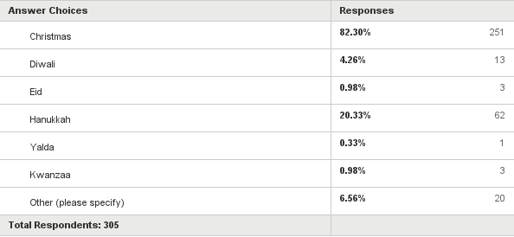
Q4: Which Fall/Winter holiday(s) do you personally celebrate? (optional)
Answered: 305 Skipped: 17

